Slide 1

Python Predictive Analysis: Forecasting Holiday Purchases

Slide 2
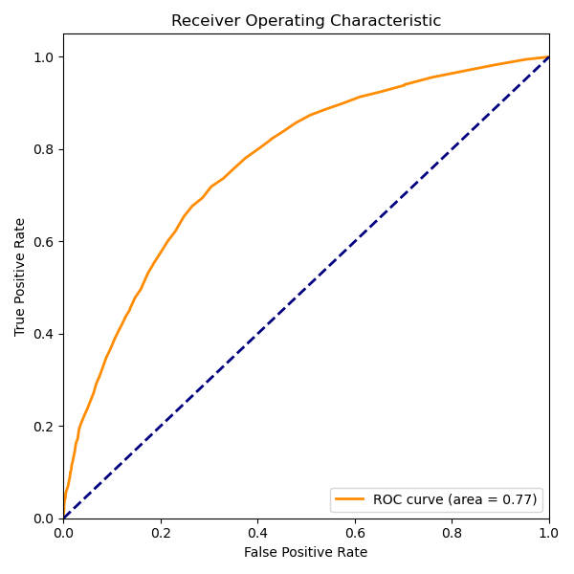
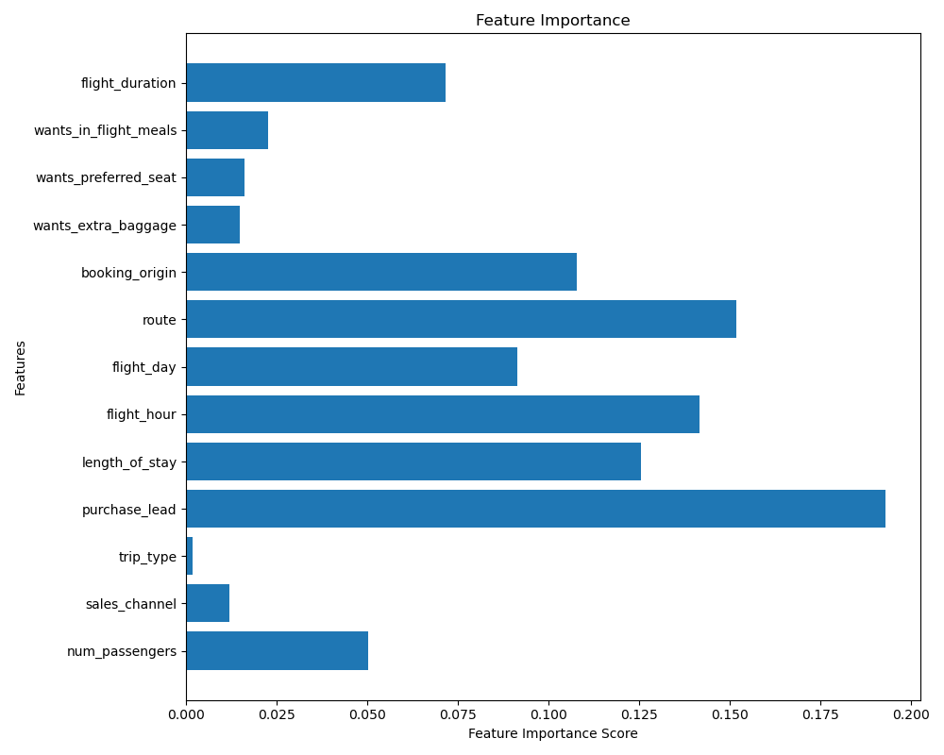
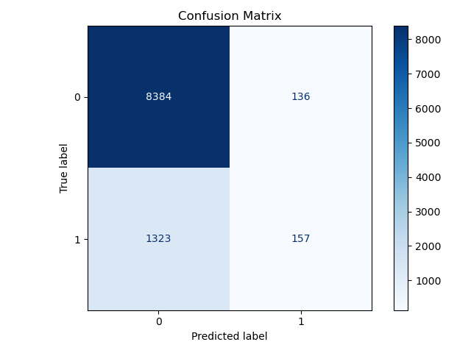
Findings
Predictive Modelling: Used Random Forest Classifier to train the data
Accuracy and AUC: The model has an accuracy of 85% and an AUC of 0.77
Precision and recall for the positive class: The precision for the positive class (class 1) is 0.54, and the recall is 0.11.
Influential factors: Purchase Lead, Route, Flight hour, Booking Origin, Flight day have a great influence on the flight booking

